Slide 1


Common c++ build issues
Andrei Toader

Slide 2
Common c++ build issues
Commonly used words and phrases found in the compiler and linker error messages:
Identifier
Read-only structure or qualifier
Initializer list
Undefined reference

Slide 3

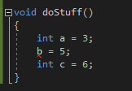
Common c++ build issues
Undeclared identifier:

Slide 4
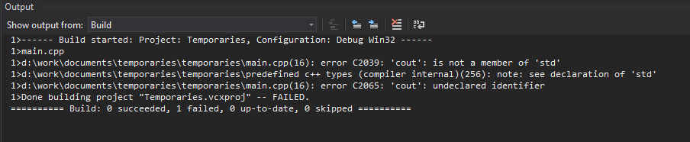

Common c++ build issues
Namespace undeclared identifier:

Slide 5
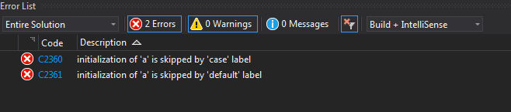
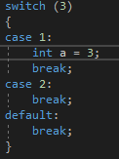
Common c++ build issues
Initialization of stack value in switch case:

Slide 6
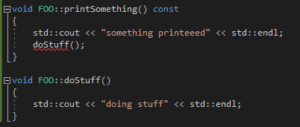
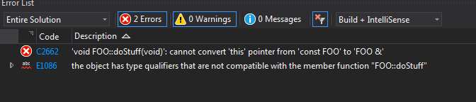
Common c++ build issues
Discards qualifier (inconsistency with the use of const):

Slide 7



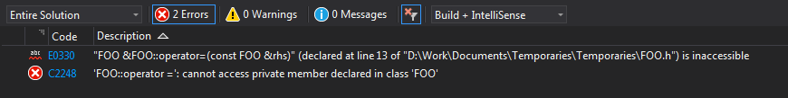
Common c++ build issues
Attempting to reference a deleted function or function is private:

Slide 8

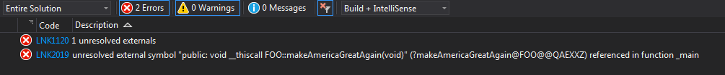
Common c++ build issues
Unresolved external or undefined reference:

Slide 9
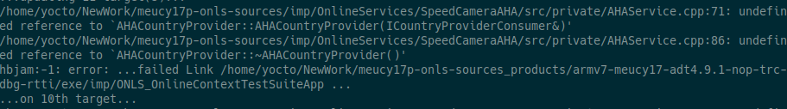
Common c++ build issues
Forget to build the “*.cpp” file:

Slide 10
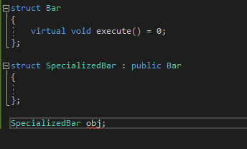
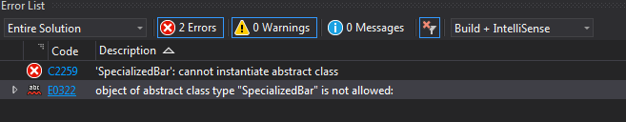
Common c++ build issues
Forget to override pure virtual function:

Slide 11
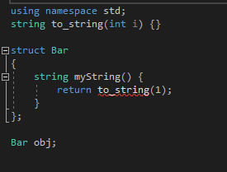
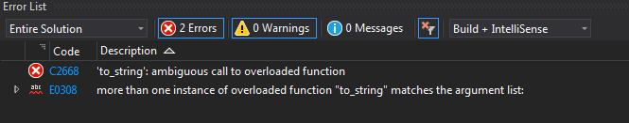
Common c++ build issues
Ambigous call to overloaded function:

Slide 12
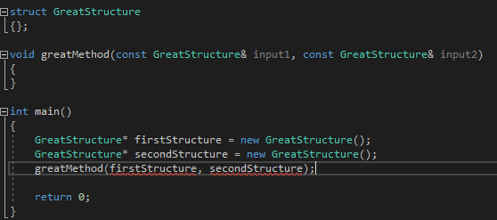
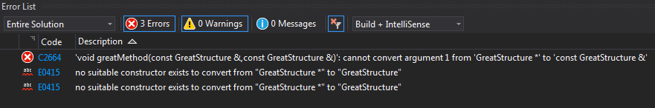
Common c++ build issues
Convert argument from … to … / no matching function for call to:

Slide 13
Common c++ build issues
Static linking vs dynamic linking
Static libraries are locked into a program at compile time (no dependency on the library at runtime).
Dynamic libraries don’t require the code to be copied, the name of the library is placed in the binary file. The actual linking happens when the program is run, when both the binary file and the library are in memory.

Slide 14
Common c++ build issues
Static linking vs dynamic linking
Build platform (x86, x64)
Windows vs Linux

Slide 15
THANK YOU

